Slide 1

PRESENTATION ON MICRO-CREDIT DEFAULTER PREDICATION USING MACHINE LEARNING
By Mr. Krishna teja dinavahi
Fliprobo – Internship 31
FLIPROBO SME: Ms. Gulshana Chaudhary

Slide 2
Overview of Presentation
What is Micro Credit?
Problem Statement.
Data Preprocessing
Exploratory data analysis.
Feature Engineering
Machine Learning Building.
ROC-AUC Curve of Different Model
ROC Curve For Final Model.
Limitations and Future Scope of work

Slide 3

What is Micro Credit?
Microcredit is an extremely small loan given to those who lack a steady source of income, collateral. It is used as a way to obtain a loan, acting as a protection against potential loss for the lender should the borrower default in his payments., or any credit history.

Slide 4
Problem Statement
Telecom provider provide micro-credit on mobile balances to be paid back in 5 days.
Loan Varity :
Loan amount of 5 - Payback amount 6 (in Indonesian Rupiah)
Loan amount of 10 - Payback amount 12 (in Indonesian Rupiah)
Task is Build ML classification Model to Predict customer who might be defaulter based on independent features.

Slide 5
DATASET Information
Dataset provide by Fliprobo Technologies Ltd.
Micro Credit Defaulter dataset contain 209593 rows and 37 columns.
Out of all features only three features with object datatypes and rest are int64.
Data integrity check is perform for missing values, duplicate data, data error.
No missing values, whitespaces, ‘NA’, ‘-’ are present in dataset.

Slide 6
Data Pre-processing
Strategy To Handle Data Error In Min And Max Column
Assumption - All negative values are typing error happen accidentally by type - in front of original value (except feature depicting median).
Corrective Approach - Negative values are converted into absolute value to correct negative typing error whenever applicable except feature depicting median.
Feature Engineering on 'pdate' column
Extracting new columns for day, month and year out of ‘pdate’

Slide 7
Data Pre-processing
Data error and correction in maxamnt_loans30 column
The maximum value in maxamnt_loans30 is not reliable.
Assumption - The maximum value in maxamnt_loans30 is 12.
Corrective Action - Replacing values greater than 12 into category of zero.
Dropping Unnecessary columns

Slide 8
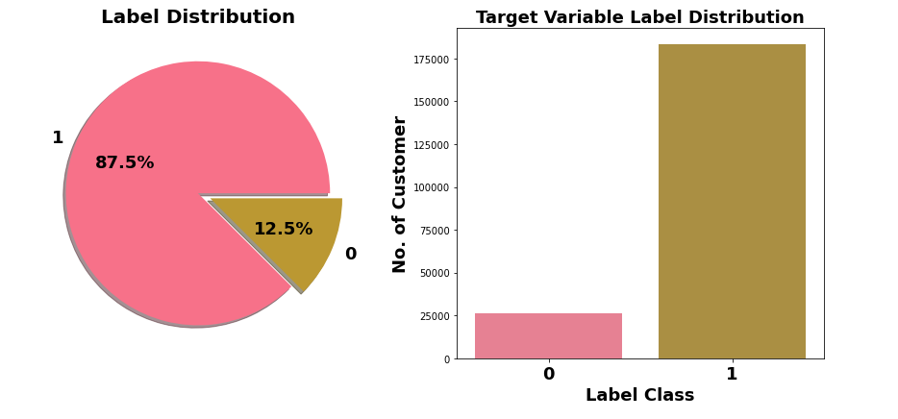
Exploratory Data Analysis Target Variable Label Distribution
Label class 1 represent non-defaulter while Label class 0 represent defaulter
Only 12.5% customers are defaulters.
Target Variable Label is imbalanced in nature.

Slide 9
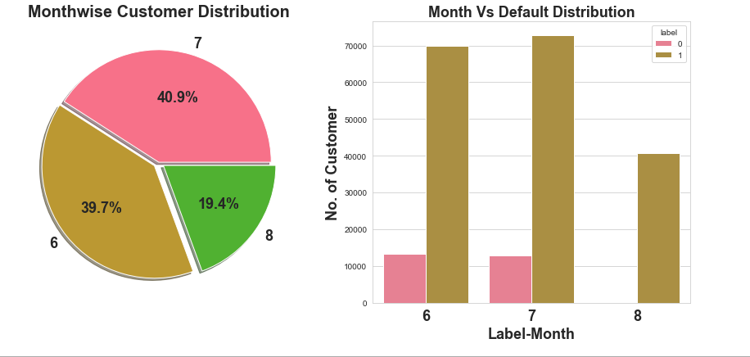
Exploratory Data Analysis Month vs defaulter distribution
Most of data belong to month 6 and 7, followed by month 8.

Slide 10
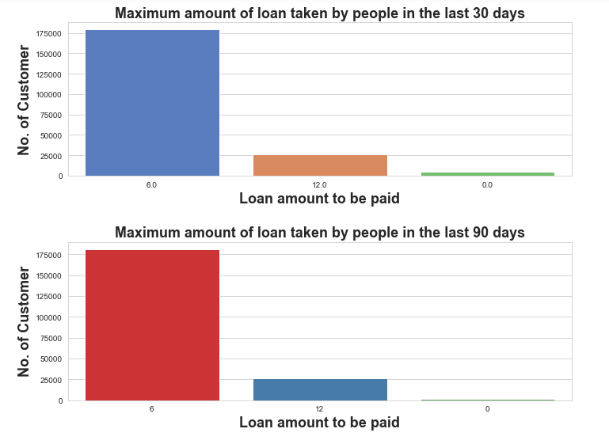
Exploratory Data Analysis Maximum amount of loan taken by customers
In 30 & 90 days, maximum number of people had taken 6Rs as the loan amount.
Customers have less tendency to take loan in amount of 12.
There are very few people who do not taken loan.

Slide 11
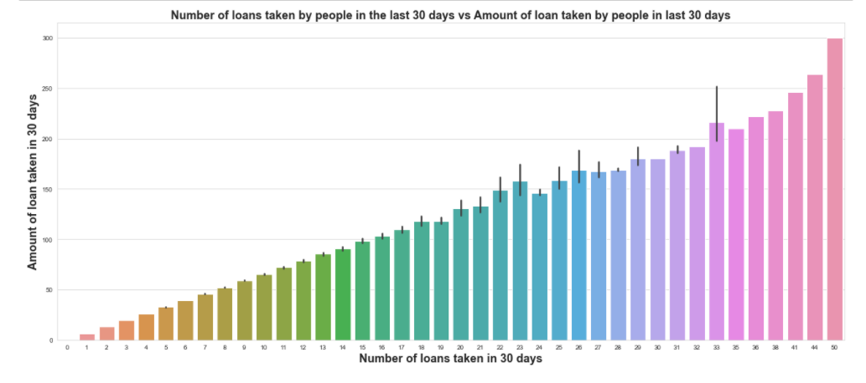
Exploratory Data Analysis Number of loan taken by customers in 30 days vs Amount of loan taken in 30 days
Maximum number of times loans taken by the people is 50 and the Average loan amount is equivalent to 300

Slide 12
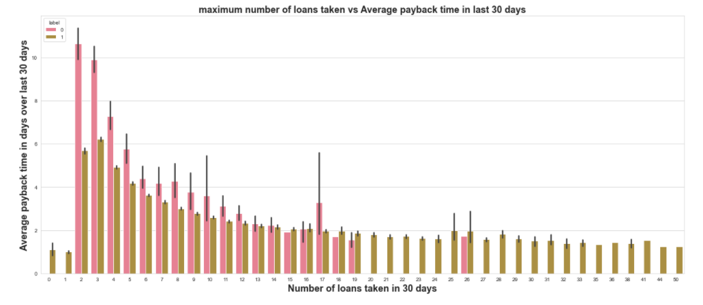
Exploratory Data Analysis Maximum Number of loan taken VS Average payback time in last 30 days
Average payback time over last 30 days is higher for people who had taken loan 2 times.

Slide 13
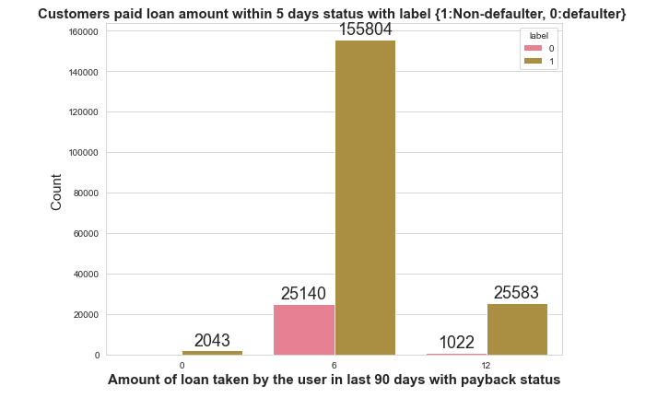
Exploratory Data Analysis Number of loan taken by customers in 30 days
Very few defaulters in case of customers who have taken loan in amount of 12.

Slide 14
Feature Engineering Outliers detection & removal
Outliers do not exist in lower bound but outliers exist in upper bound of features.
Z-score method results in huge data loss of 23.42 %, which we cannot afford.
Quantile-based Flooring- Capping Method employed for outliers removal.
Flooring is performed at 0th percentile for lower bound and capping perform at 99th percentile for upper bound.
Data Loss : 5.44 % which is acceptable.

Slide 15
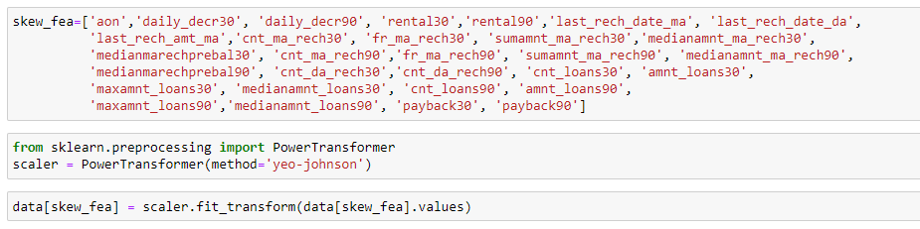
Feature Engineering Skewness detection & transformation
Considerable amount of skewness exist in different features.
Yeo-Johnson Power Transformation used to reduce skewness.

Slide 16
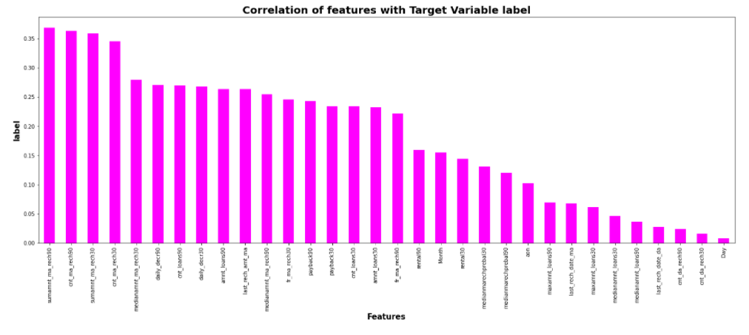
Data Inputs- Logic- Output Relationships
Most of independent features are poorly or moderately correlated with target variable label.

Slide 17
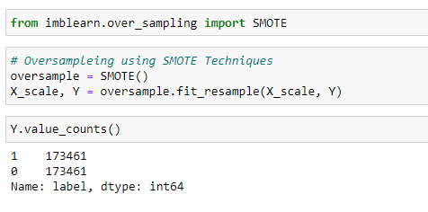
Handling IMBALANCED DATA
Target Variable label is Imbalanced in nature.
SMOTE techniques used to oversample minority class.

Slide 18
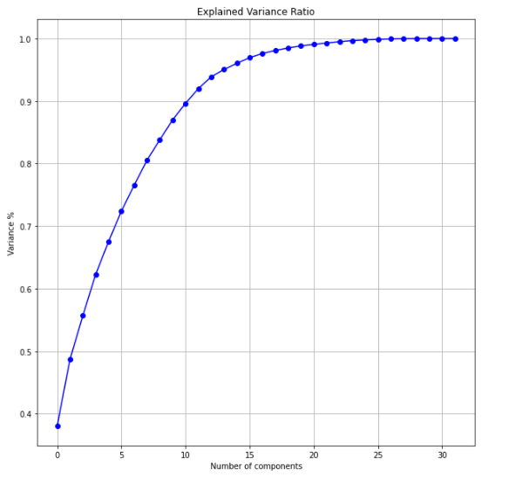
Multicollinearity and PCA
Multicollinearity exist between few features.
To resolve it PCA is applied.
Eleven principal components attribute for 90% of variation in the data.
PCA applied for Eleven components.

Slide 19
MACHINE LEARNING MODEL BUILDING
Objective is to predict customer is defaulter or not. It can be solve by application of classification ML algorithm.
Different Classification algorithm used to train model, in order to have maximum accuracy score.
Machine learning classification algorithms used in this project are –
Logistics Regression
Decision Tree Classifier
Random Forest Classifier
Extra Tree Classifier

Slide 20
ML MODEL Evaluation Matrix
Algorithm | Accuracy Score | Recall | Precision | F1 Score | CV Score | AUC Score
Logistics Regression | 0.7629 | 0.76 | 0.76 | 0.76 | 0.7626 | 0.7629
Decision Tree Classifier | 0.8530 | 0.85 | 0.85 | 0.85 | 0.8637 | 0.8531
Random Forest Classifier | 0.9175 | 0.92 | 0.92 | 0.92 | 0.9262 | 0.9175
Extra Tree Classifier (ETC) | 0.9328 | 0.93 | 0.93 | 0.93 | 0.9405 | 0.9328
Final Model (ETC- Tuned) | 0.9328 | 0.93 | 0.93 | 0.93 | 0.9404 | 0.9329
Extra Tree Classifier gives maximum accuracy score and cross validation score.
Hyper parameter tuning perform on this ETC model to gain more accuracy.
ETC –tuned model used has final model.

Slide 21
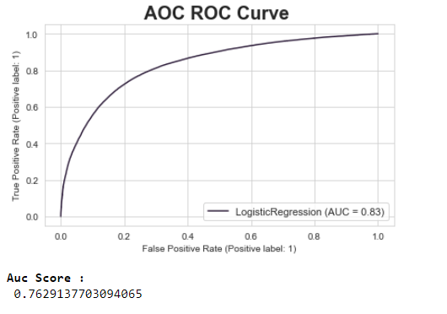
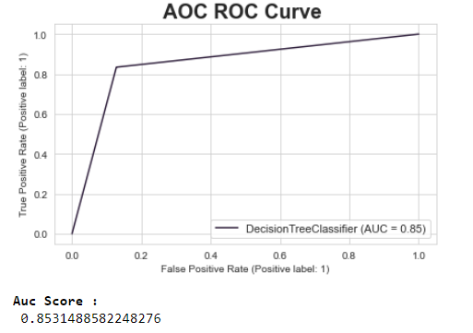
AUC-roc CURVE DIFFERENT MODELS

Slide 22
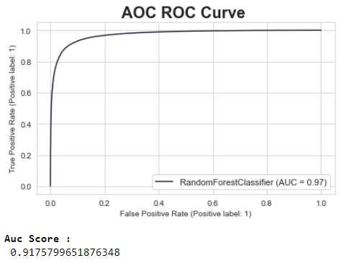
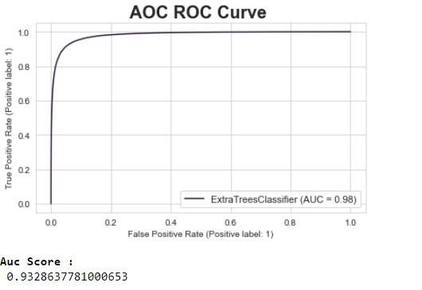
AUC-roc CURVE DIFFERENT MODELS

Slide 23
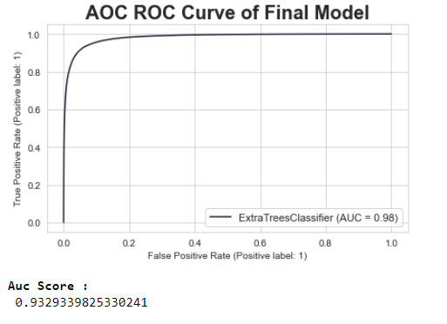
AOC – ROC CURVE OF FINAL MODEL
Extra Tree Classifier Hyper parameter tuned gives maximum accuracy score.
It also gives us maximum AUC score.

Slide 24
Limitations & Scope for Future OF THIS Work
Limited computational resources put limitation on optimization through hyper parameter tuning. Accuracy of model can increase with hyperparameter tuning with several different parameter. Here we use only two parameters for tuning.
Data is imbalanced, we utilised SMOTE for it but if get label data which at least in ratio of 70:30, It can give us much more realistic model.

Slide 25


